Slide 1
Offer Letter PDF Generator
Internship Project - Python Flask by N.CHETHAN REDDY

Slide 2
Abstract
This project implements an on-the-fly PDF offer letter generator using Python and Flask. User details are submitted through a web form, and a customized offer letter is generated and served instantly as a downloadable PDF without saving it on the server. The PDF includes candidate name, domain, duration, and start date.

Slide 3
Technologies Used
- Python 3
- Flask Web Framework
- ReportLab Library (PDF generation)
- HTML Form (via Flask route)
- BytesIO (for memory-based file streaming)

Slide 4
Key Features
- On-the-fly PDF generation
- Instant file download without saving
- Input: Name, College, Domain, Duration, Start Date
- Custom-styled PDF with ReportLab
- Fully backend-powered using Flask

Slide 5
How It Works
1. User fills out the internship form on the homepage.
2. Data is sent via POST request to Flask `/generate` route.
3. ReportLab creates a PDF in memory with personalized content.
4. Flask sends the PDF file directly in response.
5. User downloads the offer letter instantly.

Slide 6
Simulated Output (Web Form)
Name: Mukesh Reddy
College: ABC Institute of Technology
Domain: Python Development
Duration: 6 weeks
Start Date: 2025-06-15
[Generate PDF]

Slide 7
Conclusion
This Python Flask project demonstrates how to dynamically generate PDF files from user-submitted web forms. It's ideal for internship portals that need to generate certificates, offer letters, or reports on-demand in a clean and scalable way.

Slide 8

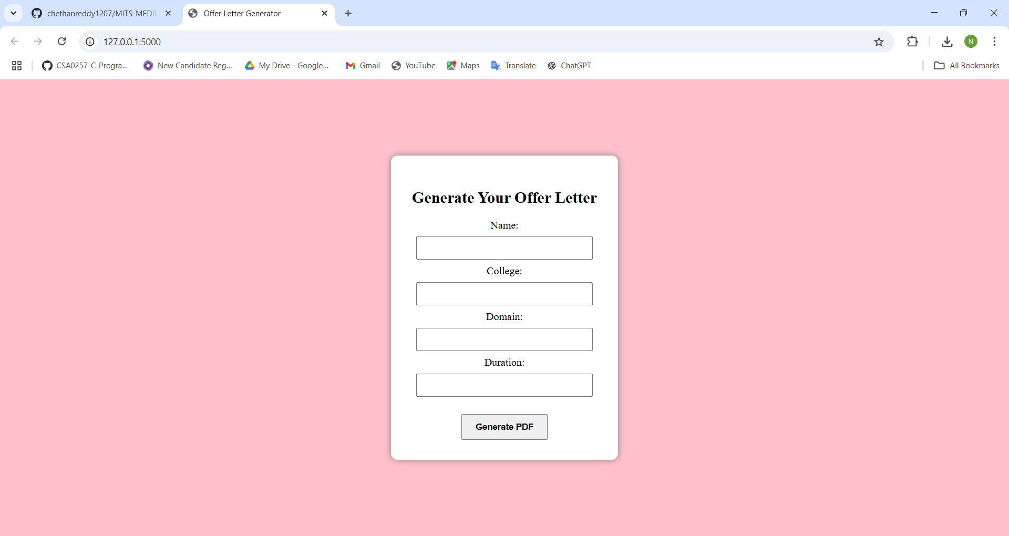
DETAILS FOR GENERATING OFFER LETTER

Slide 9
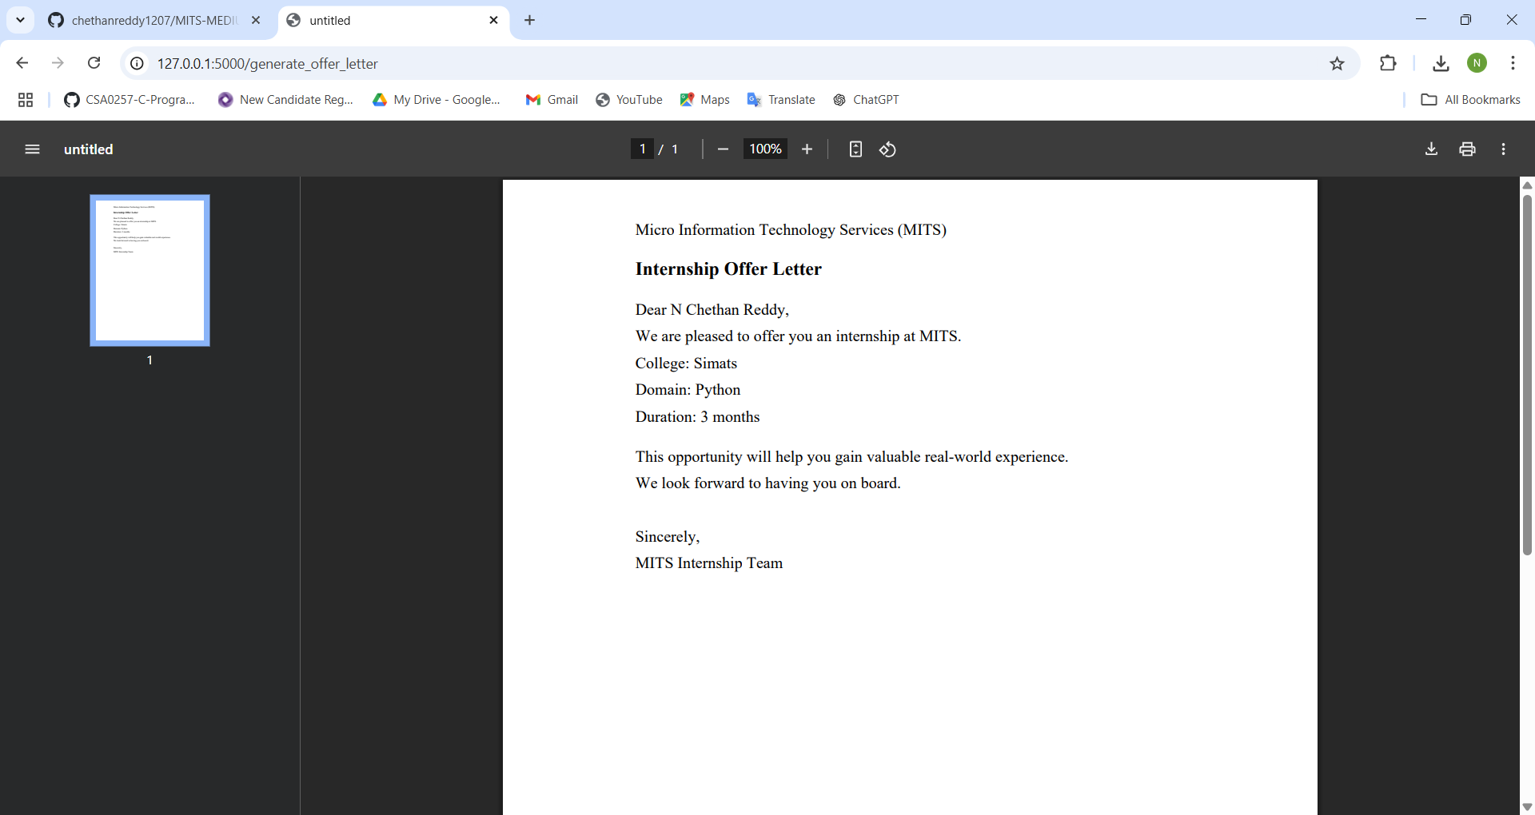
OFFER LETTER GENERATED.PDF

